Slide 1
SC22: Using containers for reproducibility of scientific results for AE/AD submission
Prof. Sameer Shende, University of Oregon

Slide 2
Using Containers for Reproducibility of Scientific Results
Containers have ushered in a new era of reproducibility of scientific results. This talk will focus on using and building custom containers that support CPU and GPU platforms on x86_64, ppc64le, and aarch64 with support for GPUs from NVIDIA, Intel, and AMD. It will demonstrate techniques for deploying these base and full-featured images from E4S [https://e4s.io] to build tools that may be described in SC papers for AE/AD submission.

Slide 3

What are containers?
A lightweight collection of executable software that encapsulates everything needed to run a single specific task
  Minus the OS kernel
  Based on Linux only
Processes and all user-level software is isolated
Creates a portable software ecosystem
Think chroot on steroids
Docker most common tool today
  Available on all major platforms
  Widely used in industry
  Integrated container registry via Dockerhub

Slide 4
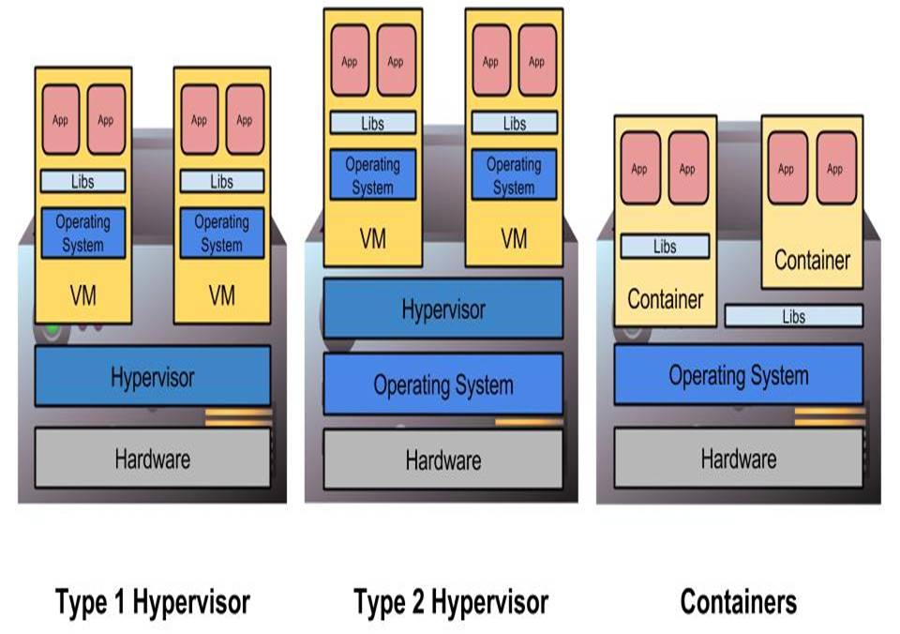
Hypervisors and Containers
Type 1 hypervisors insert layer below host OS
Type 2 hypervisors work as or within the host OS
Containers do not abstract hardware, instead provide “enhanced chroot” to create isolated environment
Location of abstraction can have impact on performance
All enable custom software stacks on existing hardware

Slide 5
Containers in HPC
BYOE - Bring-Your-Own-Environment
  Developers define the operating environment and system libraries in which their application runs.
Composability
  Developers explicitly define how their software environment is composed of modular components as container images,
  Enable reproducible environments that can potentially span different architectures.
Portability
  Containers can be rebuilt, layered, or shared across multiple different computing systems
  Potentially from laptops to clouds to advanced supercomputing resources.
Version Control Integration
  Containers integrate with revision control systems like Git
  Include not only build manifests but also with complete container images using container registries like Docker Hub.
  Tutorial: https://www.supercontainers.org
  https://supercontainers.github.io/sc-tutorials

Slide 6
Extreme-scale Scientific Software Stack (E4S)
  Motivation: As our software gets more complex, it is getting harder to stall tools and libraries correctly in an integrated and interoperable software stack.
  E4S is a curated, Spack based software distribution of HPC & AI/ML packages and includes Intel oneAPI, NVHPC, ROCm.
  E4S features binary build-caches, recipes, and containers:
    Base images, base images with GPU runtimes, full-featured
    From a base image, you can derive an image that includes your application.
  https://e4s.io

Slide 7


Extreme-scale Scientific Software Stack (E4S)
E4S: HPC Software Ecosystem – a curated software portfolio
A Spack-based distribution of software tested for interoperability and portability to multiple architectures with support for GPUs from NVIDIA, AMD, and Intel in a single distribution
Available from source, containers, cloud, binary caches
Leverages and enhances SDK interoperability thrust
Not a commercial product – an open resource for all
Oct 2018: E4S 0.1 - 24 full, 24 partial release products
Jan 2019: E4S 0.2 - 37 full, 10 partial release products
Nov 2019: E4S 1.0 - 50 full, 5 partial release products
Feb 2020: E4S 1.1 - 61 full release products
Nov 2020: E4S 1.2 (aka, 20.10) - 67 full release products
Feb 2021: E4S 21.02 - 67 full release, 4 partial release
May 2021: E4S 21.05 - 76 full release products
Aug 2021: E4S 21.08 - 88 full release products
Nov 2021: E4S 21.11 - 91 full release products
Feb 2022: E4S 22.02 – 100 full release products
https://e4s.io
SC22: Using containers for reproducibility of scientific results for AE/AD submission

Slide 8
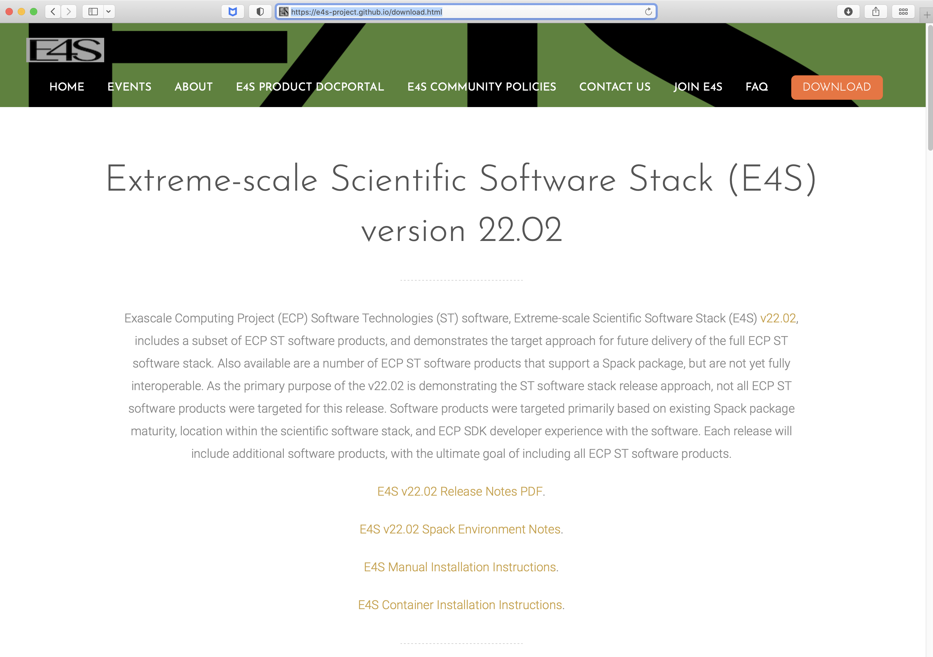
E4S Download: https://e4s.io

Slide 9

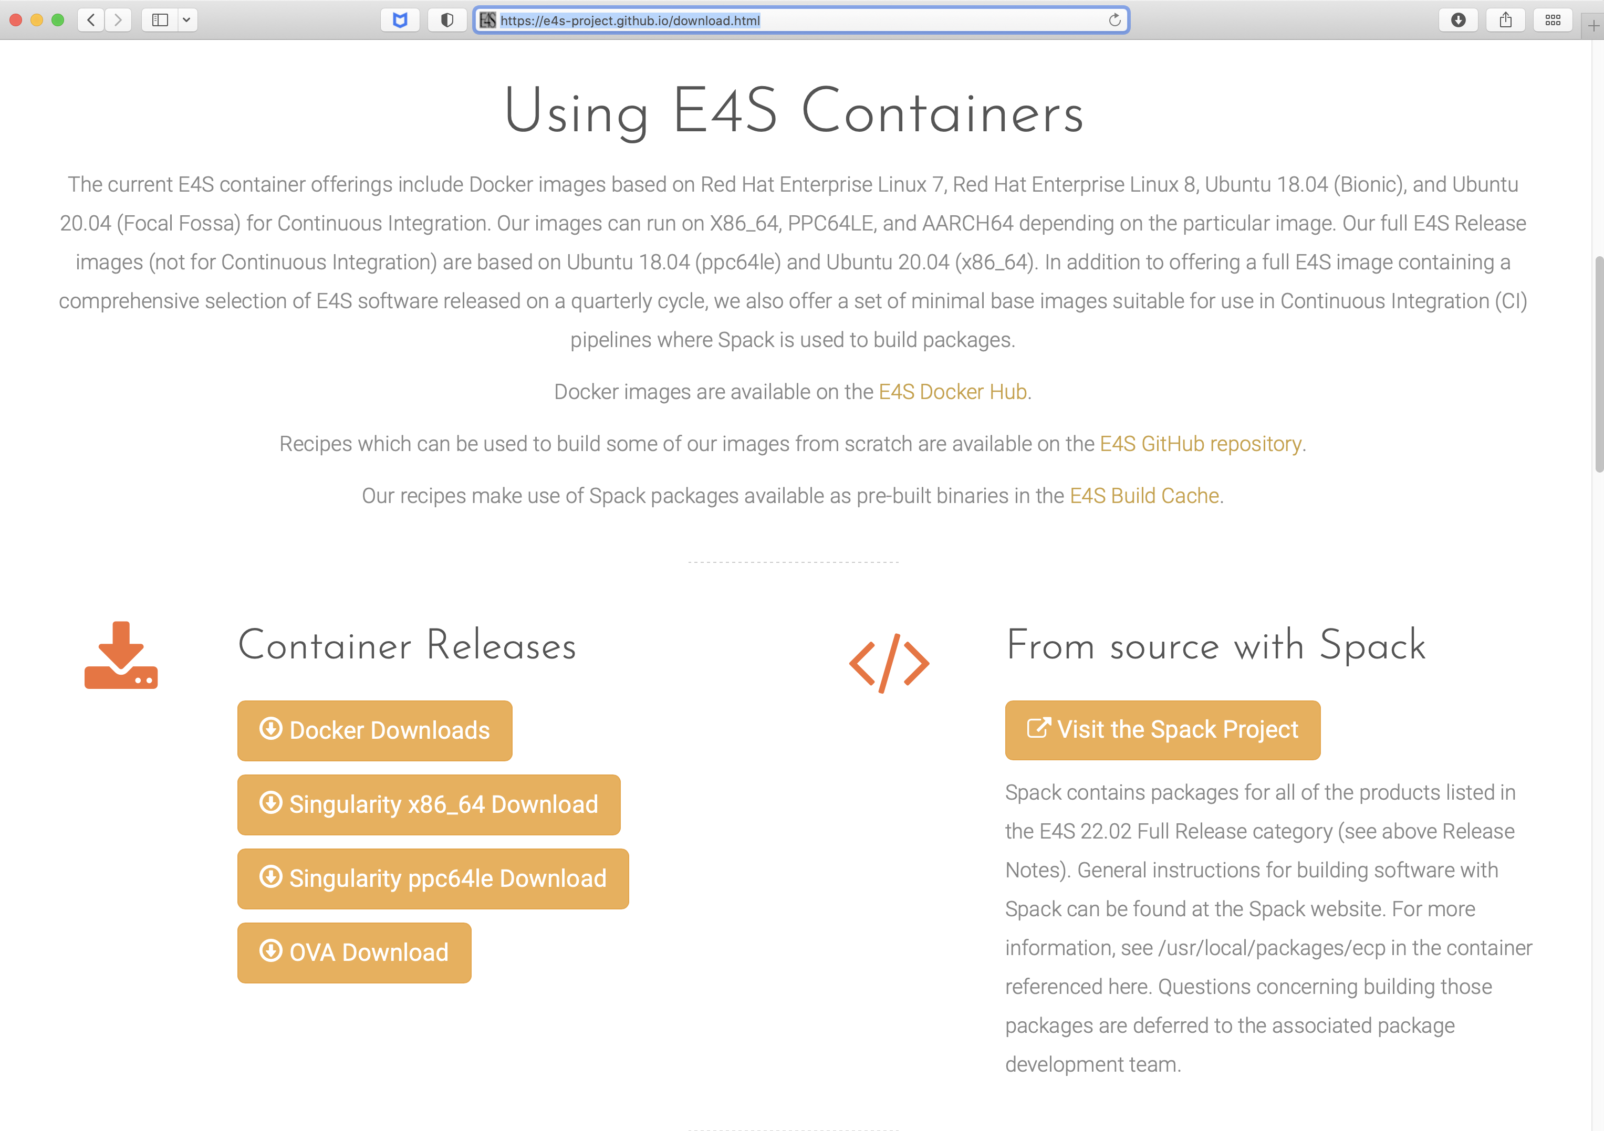
Download E4S 22.02: GPU container image: NVIDIA, AMD, Intel
Full featured Singularity image [Sylabs.io]
GPU base images for
  x86_64 (Intel, AMD, NVIDIA)
  ppc64le
  aarch64
Packages with support for all three GPU runtimes:
  Kokkos
  TAU

Slide 10
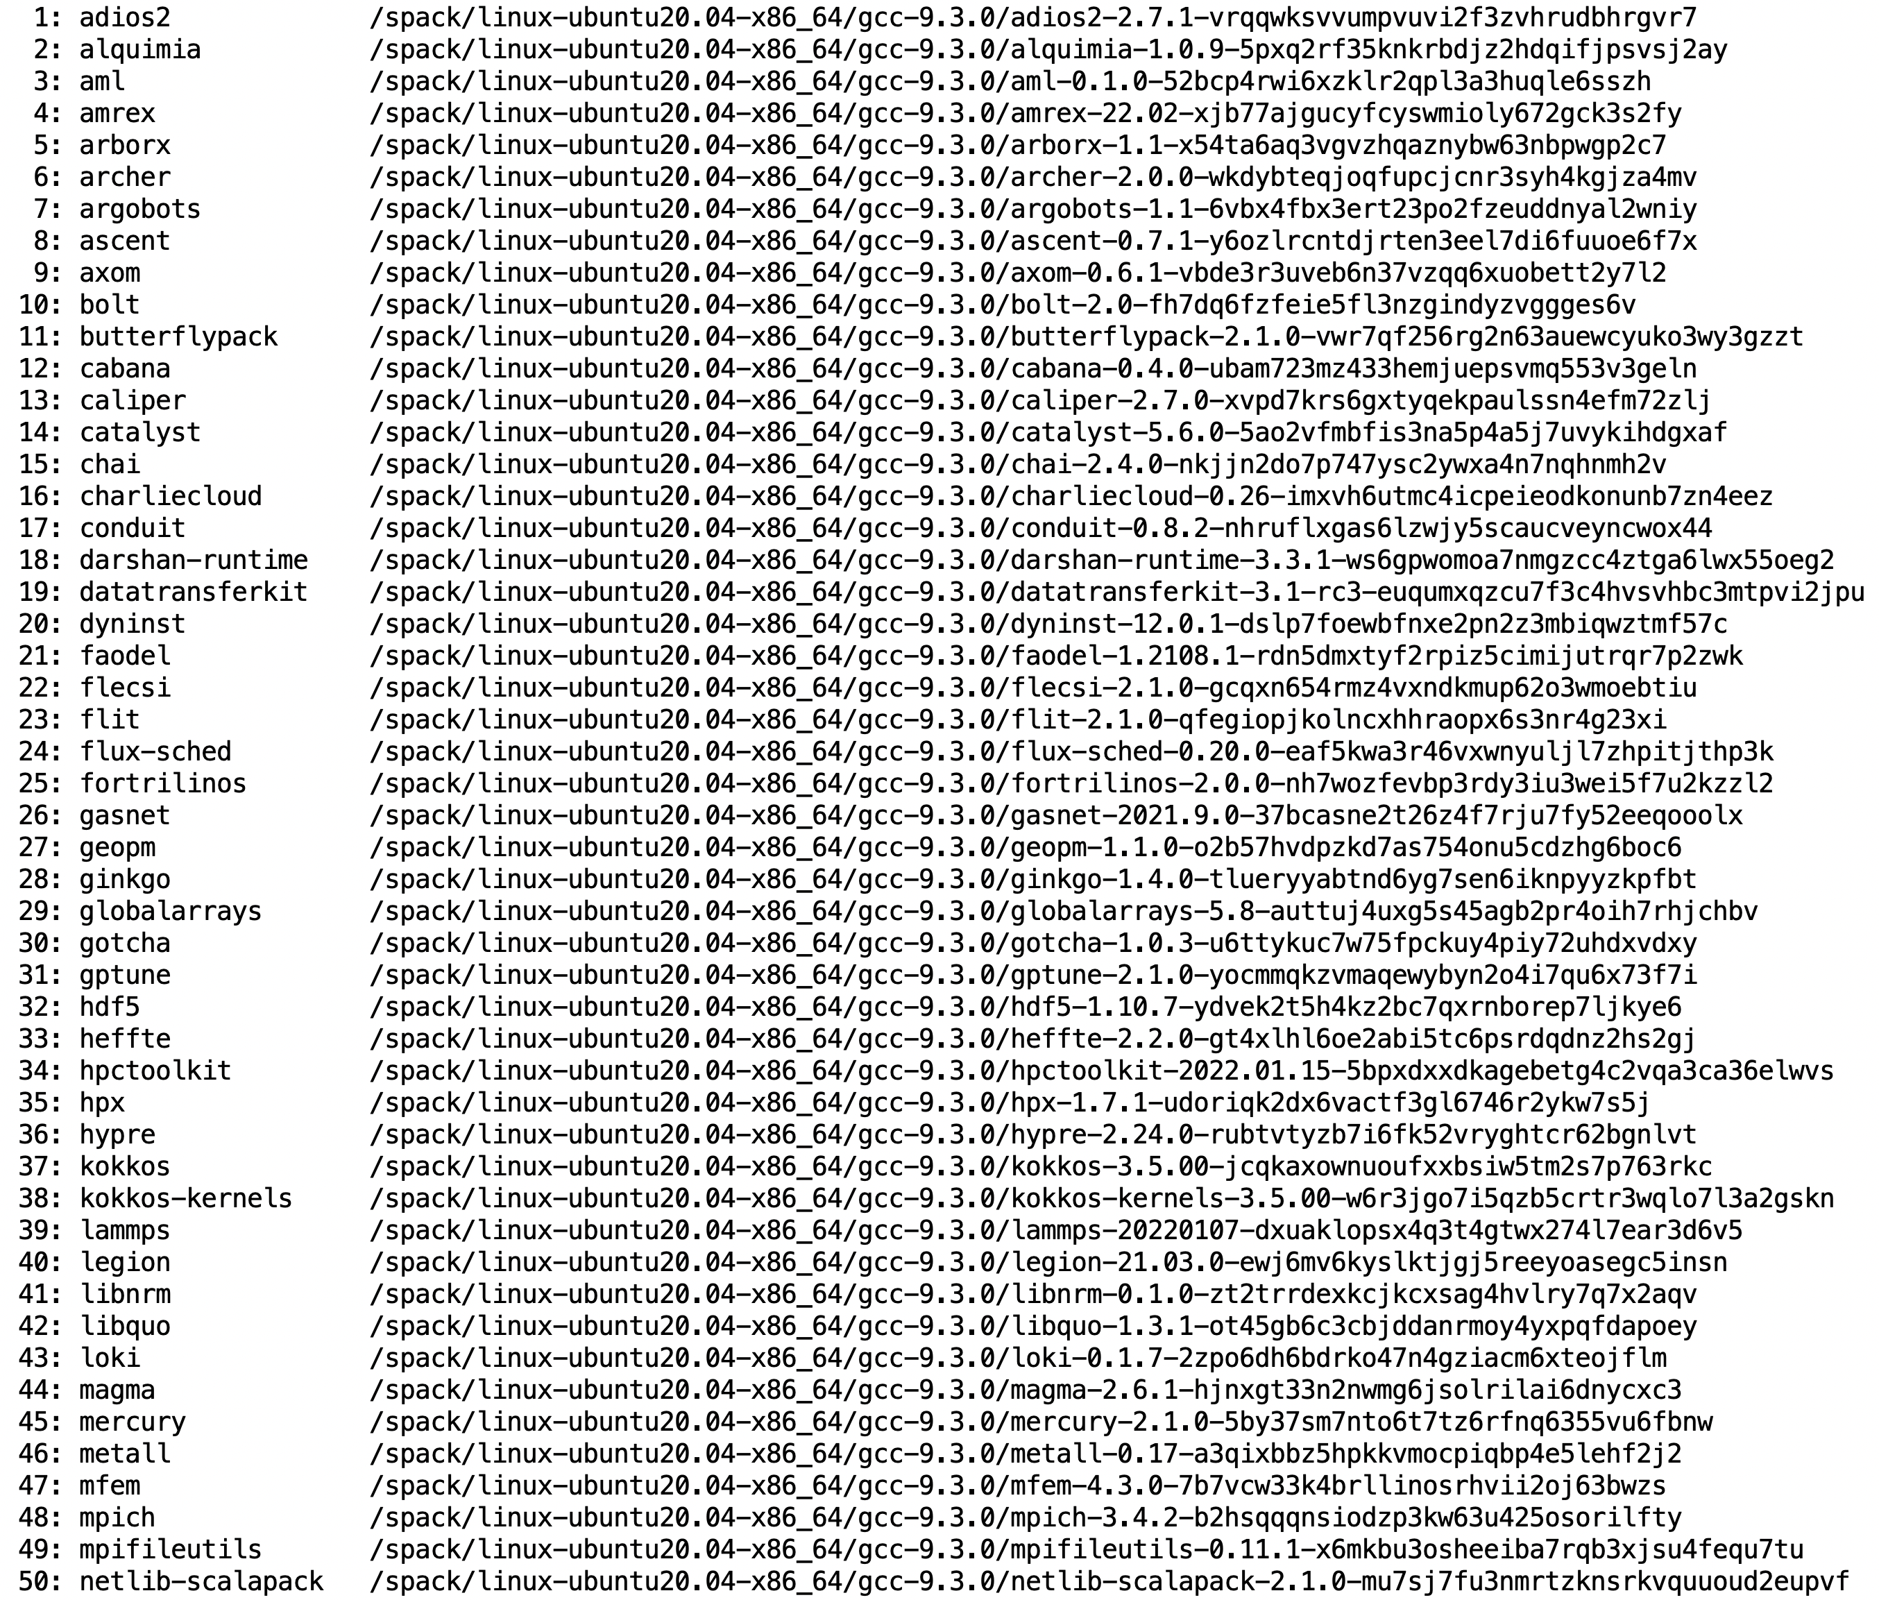
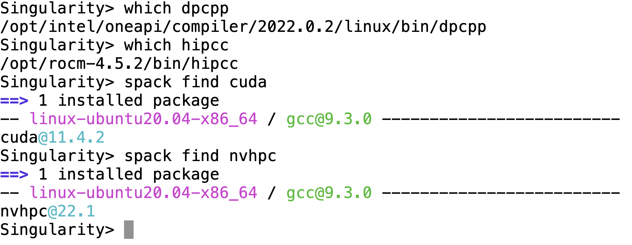
22.02 Release: 100 Official Products + dependencies (gcc, x86_64)
GPU runtimes
Intel (oneAPI)
  2022.0.2
AMD (ROCm)
  4.5.2
NVIDIA (CUDA)
  11.4.2
NVHPC
  22.1
SC22: Using containers for reproducibility of scientific results for AE/AD submission

Slide 11
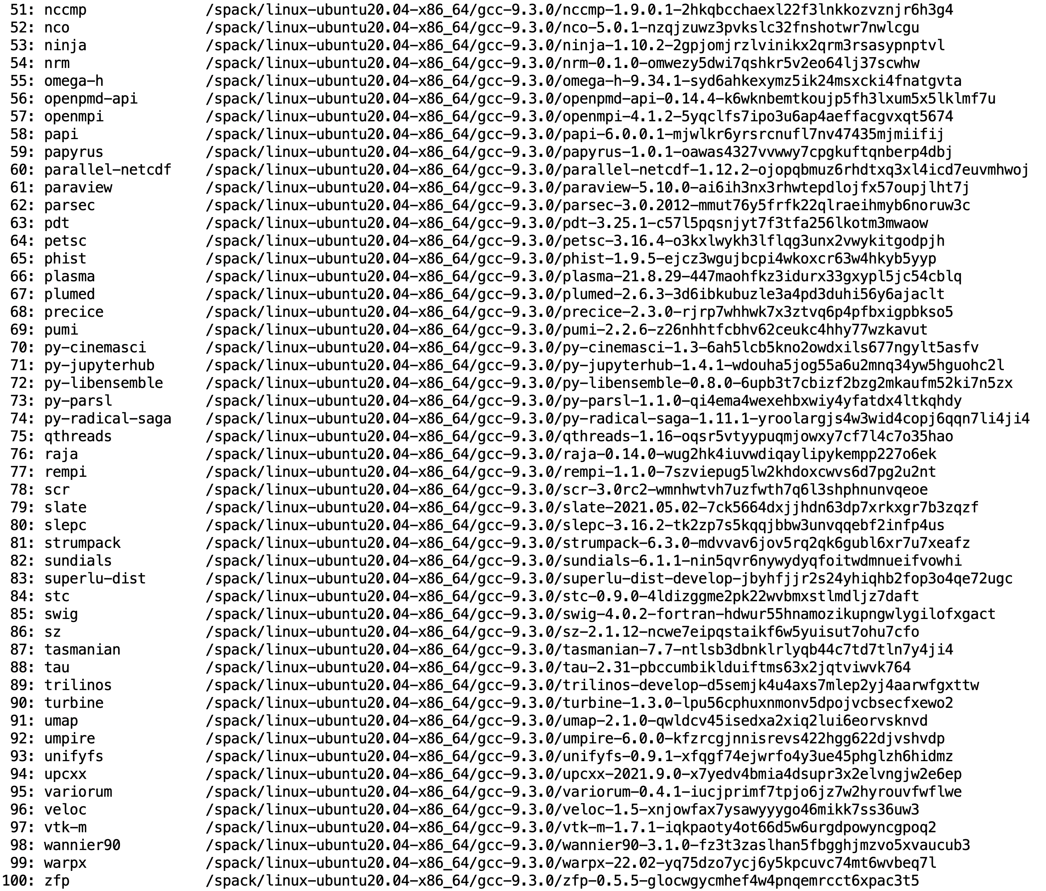
22.02 Release: 100 Official Products + dependencies (gcc, x86_64)
Languages:
Julia
Python
AI products with GPU support
Tensorflow
Pytorch
3D Visualization
Paraview
VisIt
TAU’s paraprof …
SC22: Using containers for reproducibility of scientific results for AE/AD submission

Slide 12
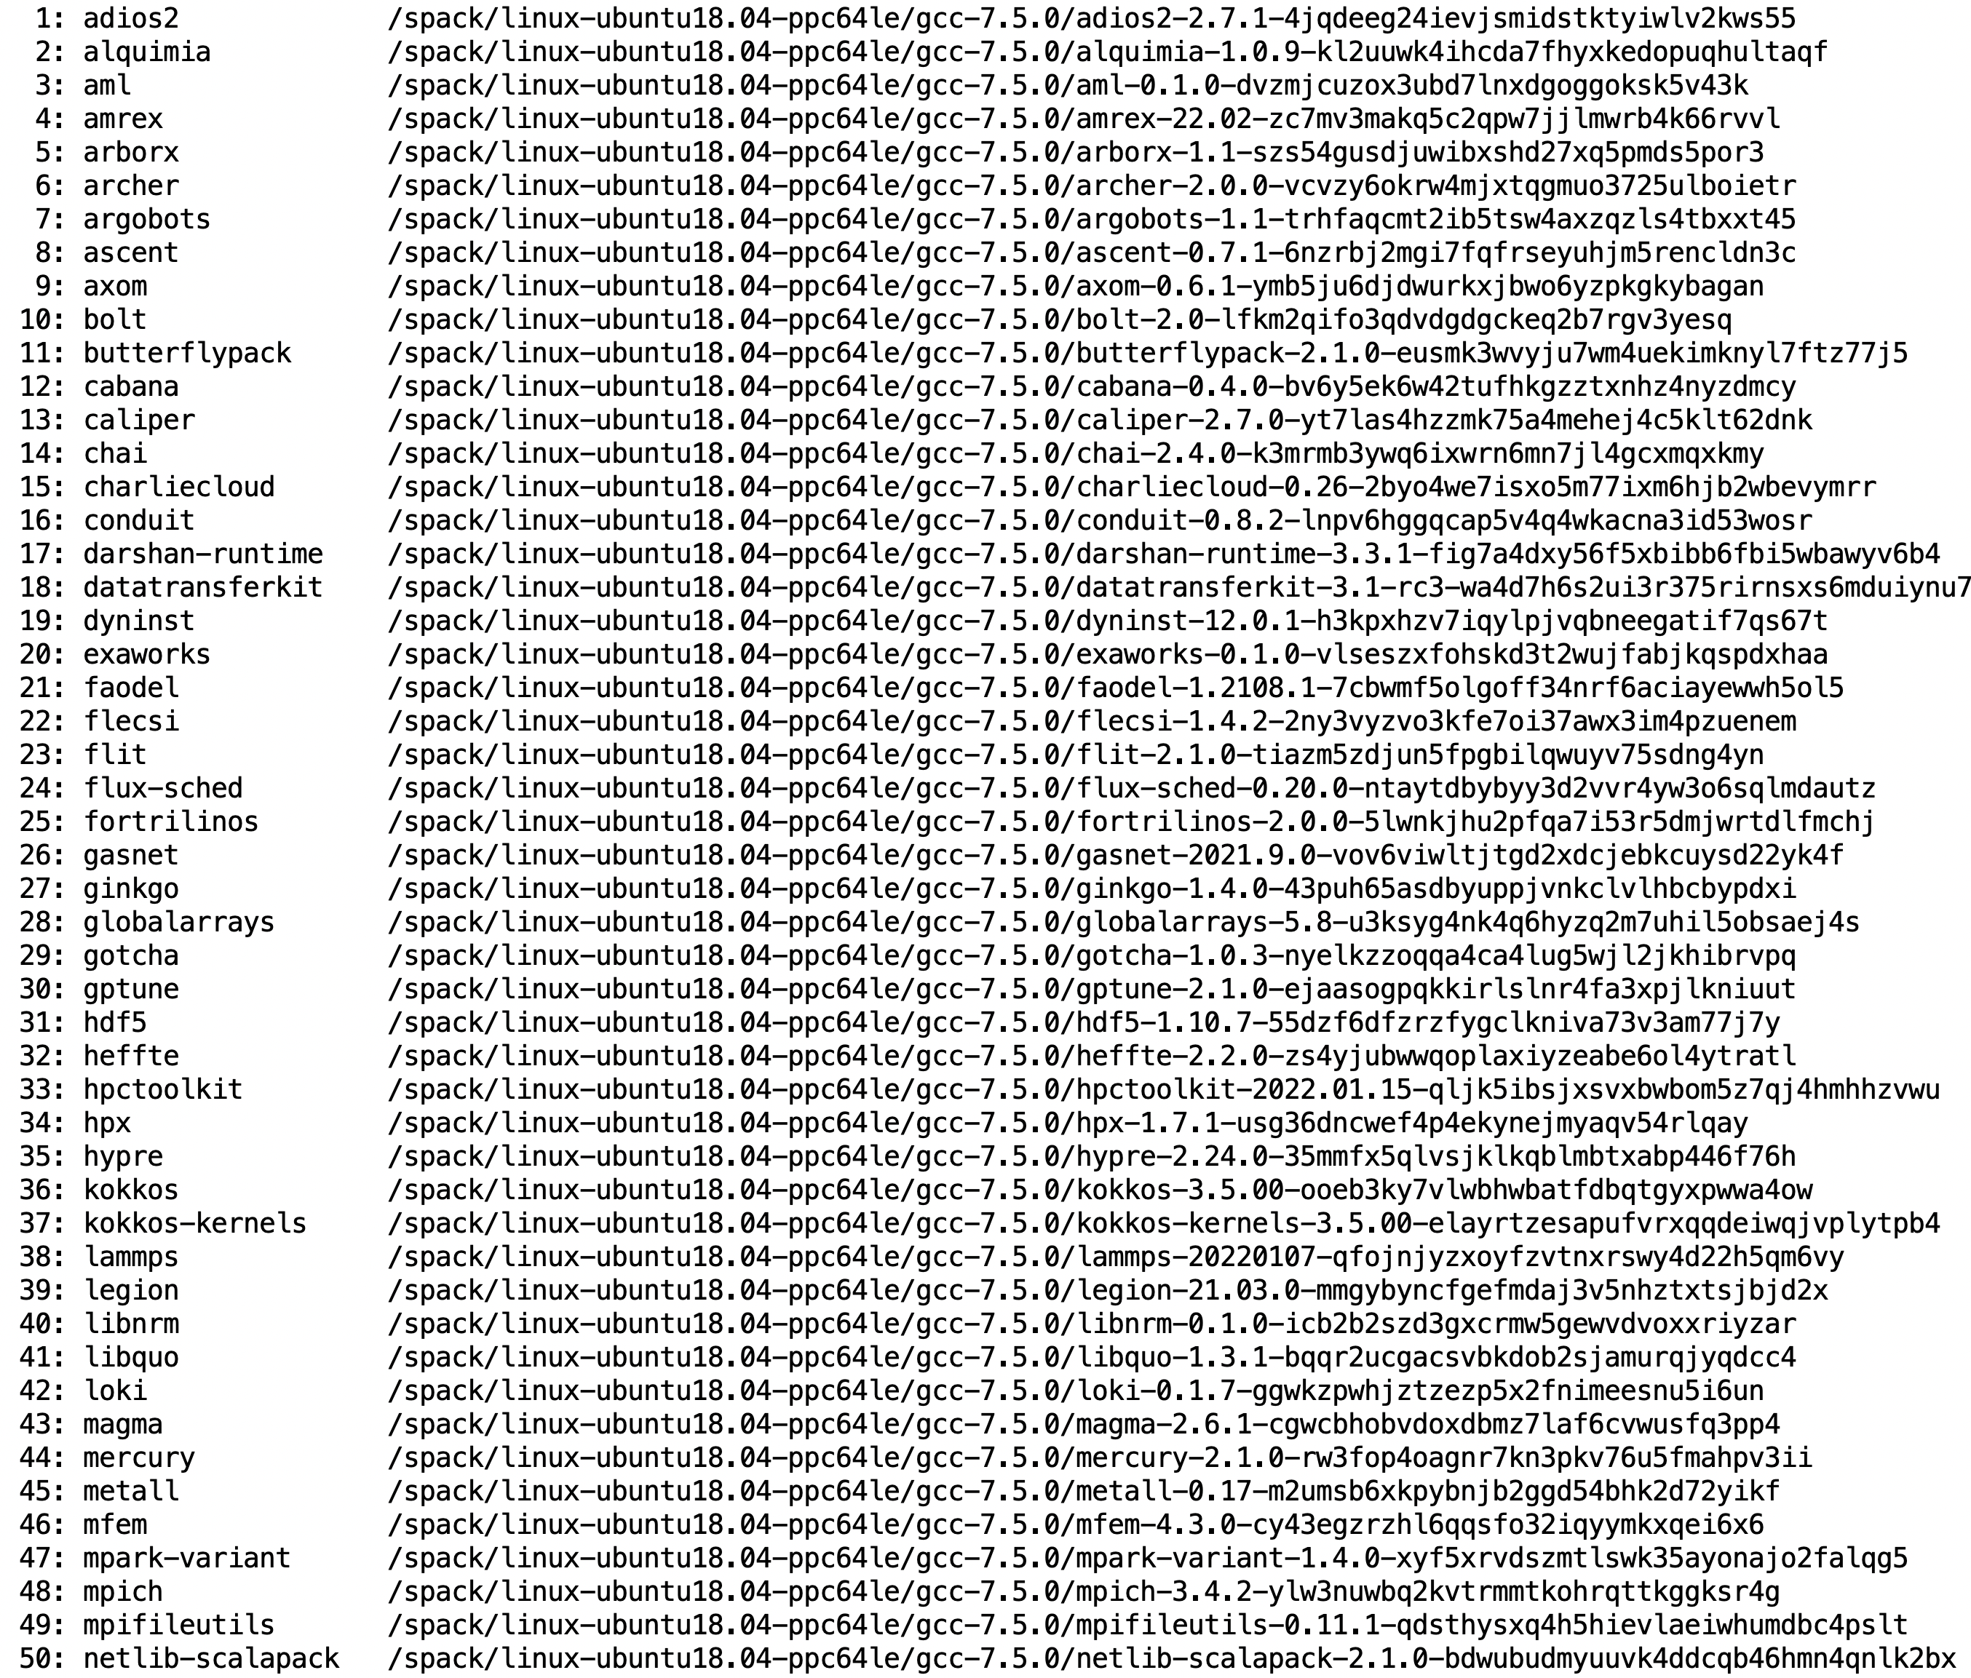
22.02 Release: 100 Official Products + dependencies (gcc, ppc64le)
GPU runtimes for IBM Power
CUDA 11
NVHPC 22.1
Languages
Julia
Python
AI packages for NVIDIA GPU
TensorFlow
PyTorch
SC22: Using containers for reproducibility of scientific results for AE/AD submission

Slide 13
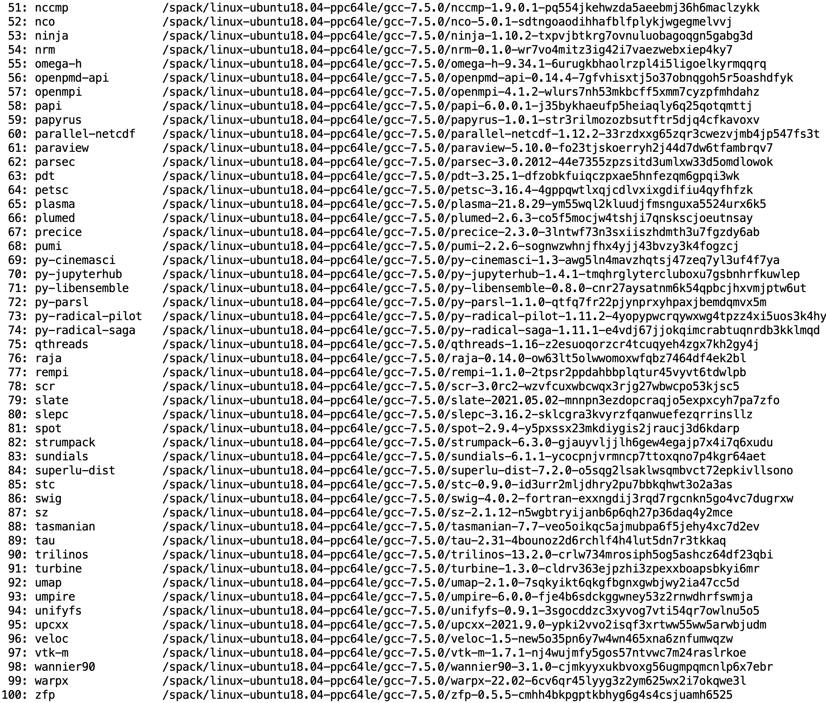
22.02 Release: 100 Official Products + dependencies (gcc, ppc64le)
100 packages: x86_64 and ppc64le
Spack package manager [spack.io]
Environment modules
AI/ML Python (Tensorflow/PyTorch)
% singularity run [--nv|--rocm] e4s.sif
  conda activate rocm
  conda activate cuda
SC22: Using containers for reproducibility of scientific results for AE/AD submission

Slide 14
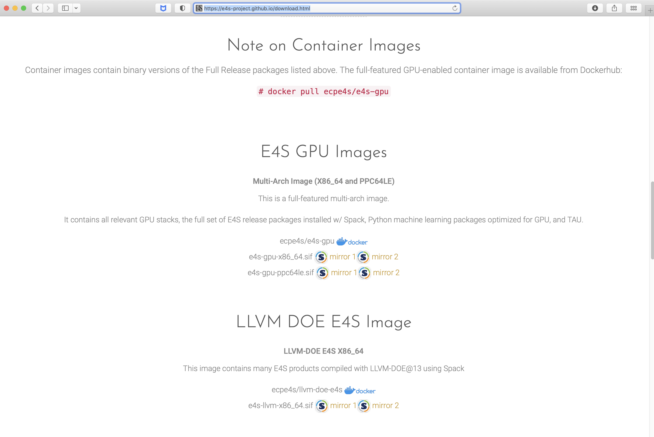
E4S 22.02 Release: full featured GPU image, LLVM DOE image
Full featured images
  ppc64le and x86_64
  Docker and Singularity
LLVM DOE E4S image
SC22: Using containers for reproducibility of scientific results for AE/AD submission
Notes:
quick run through - what ECP ST is working on

Slide 15
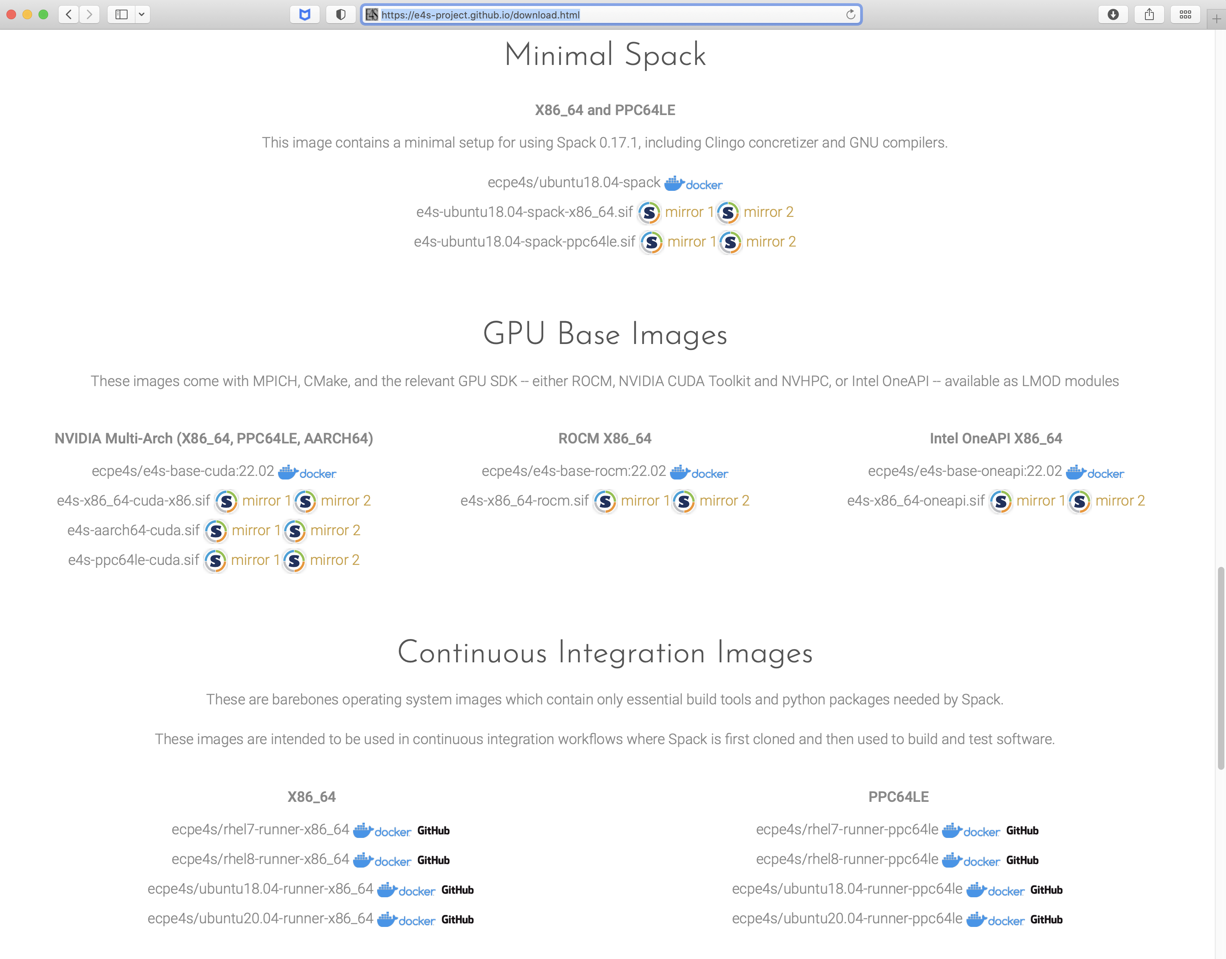
E4S base container images for x86_64, ppc64le, and aarch64
Hub.docker.com
ecpe4s
Platforms:
  x86_64
  ppc64le
  aarch64
GPU runtimes:
  Cuda
  ROCm
  oneAPI
Singularity images
Miminal Spack image
SC22: Using containers for reproducibility of scientific results for AE/AD submission
Notes:
quick run through - what ECP ST is working on

Slide 16
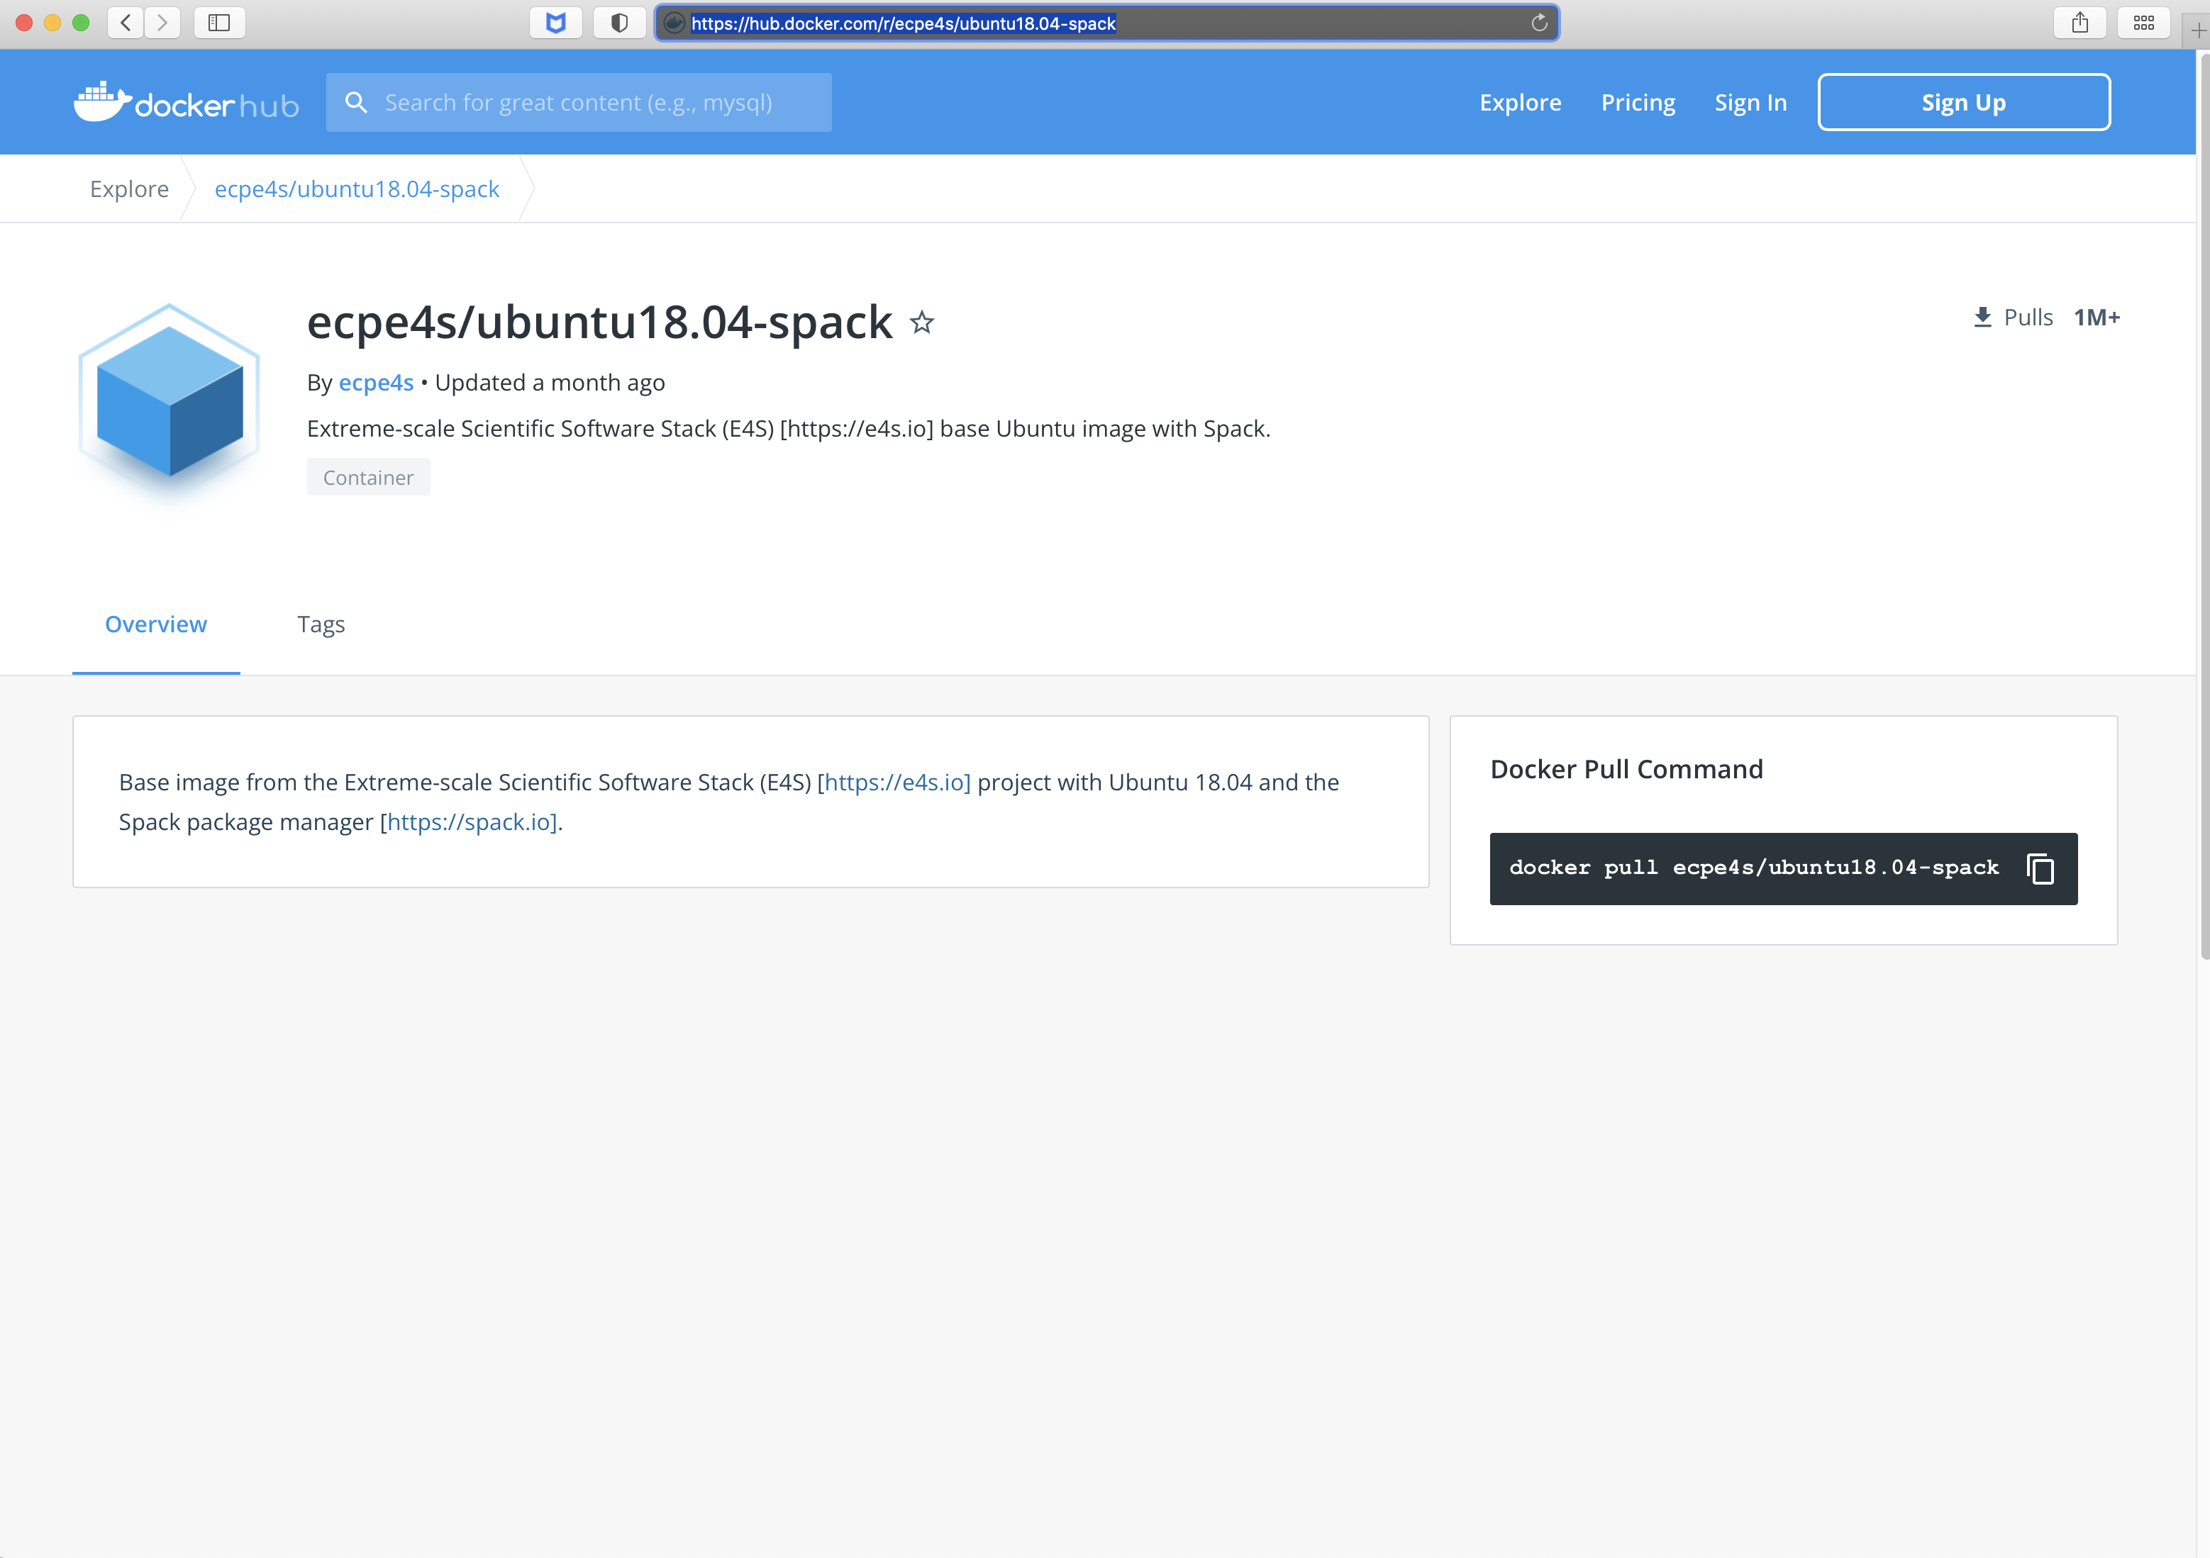
E4S 22.02 Minimal Base Image: Ubuntu
Create custom
container images
1M+ downloads!
https://hub.docker.com

Slide 17
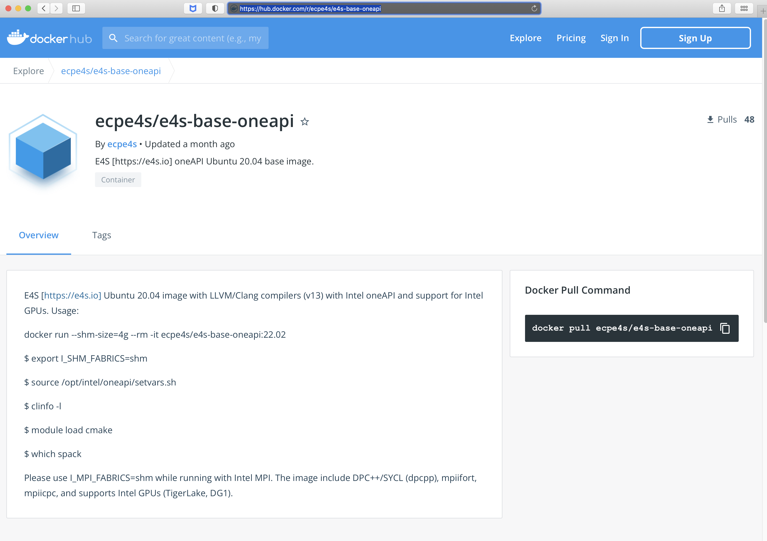
E4S 22.02 Intel GPU Base Image: Ubuntu
Includes gcc, LLVM, and
Intel compilers (oneAPI)
Supports Intel GPUs

Slide 18
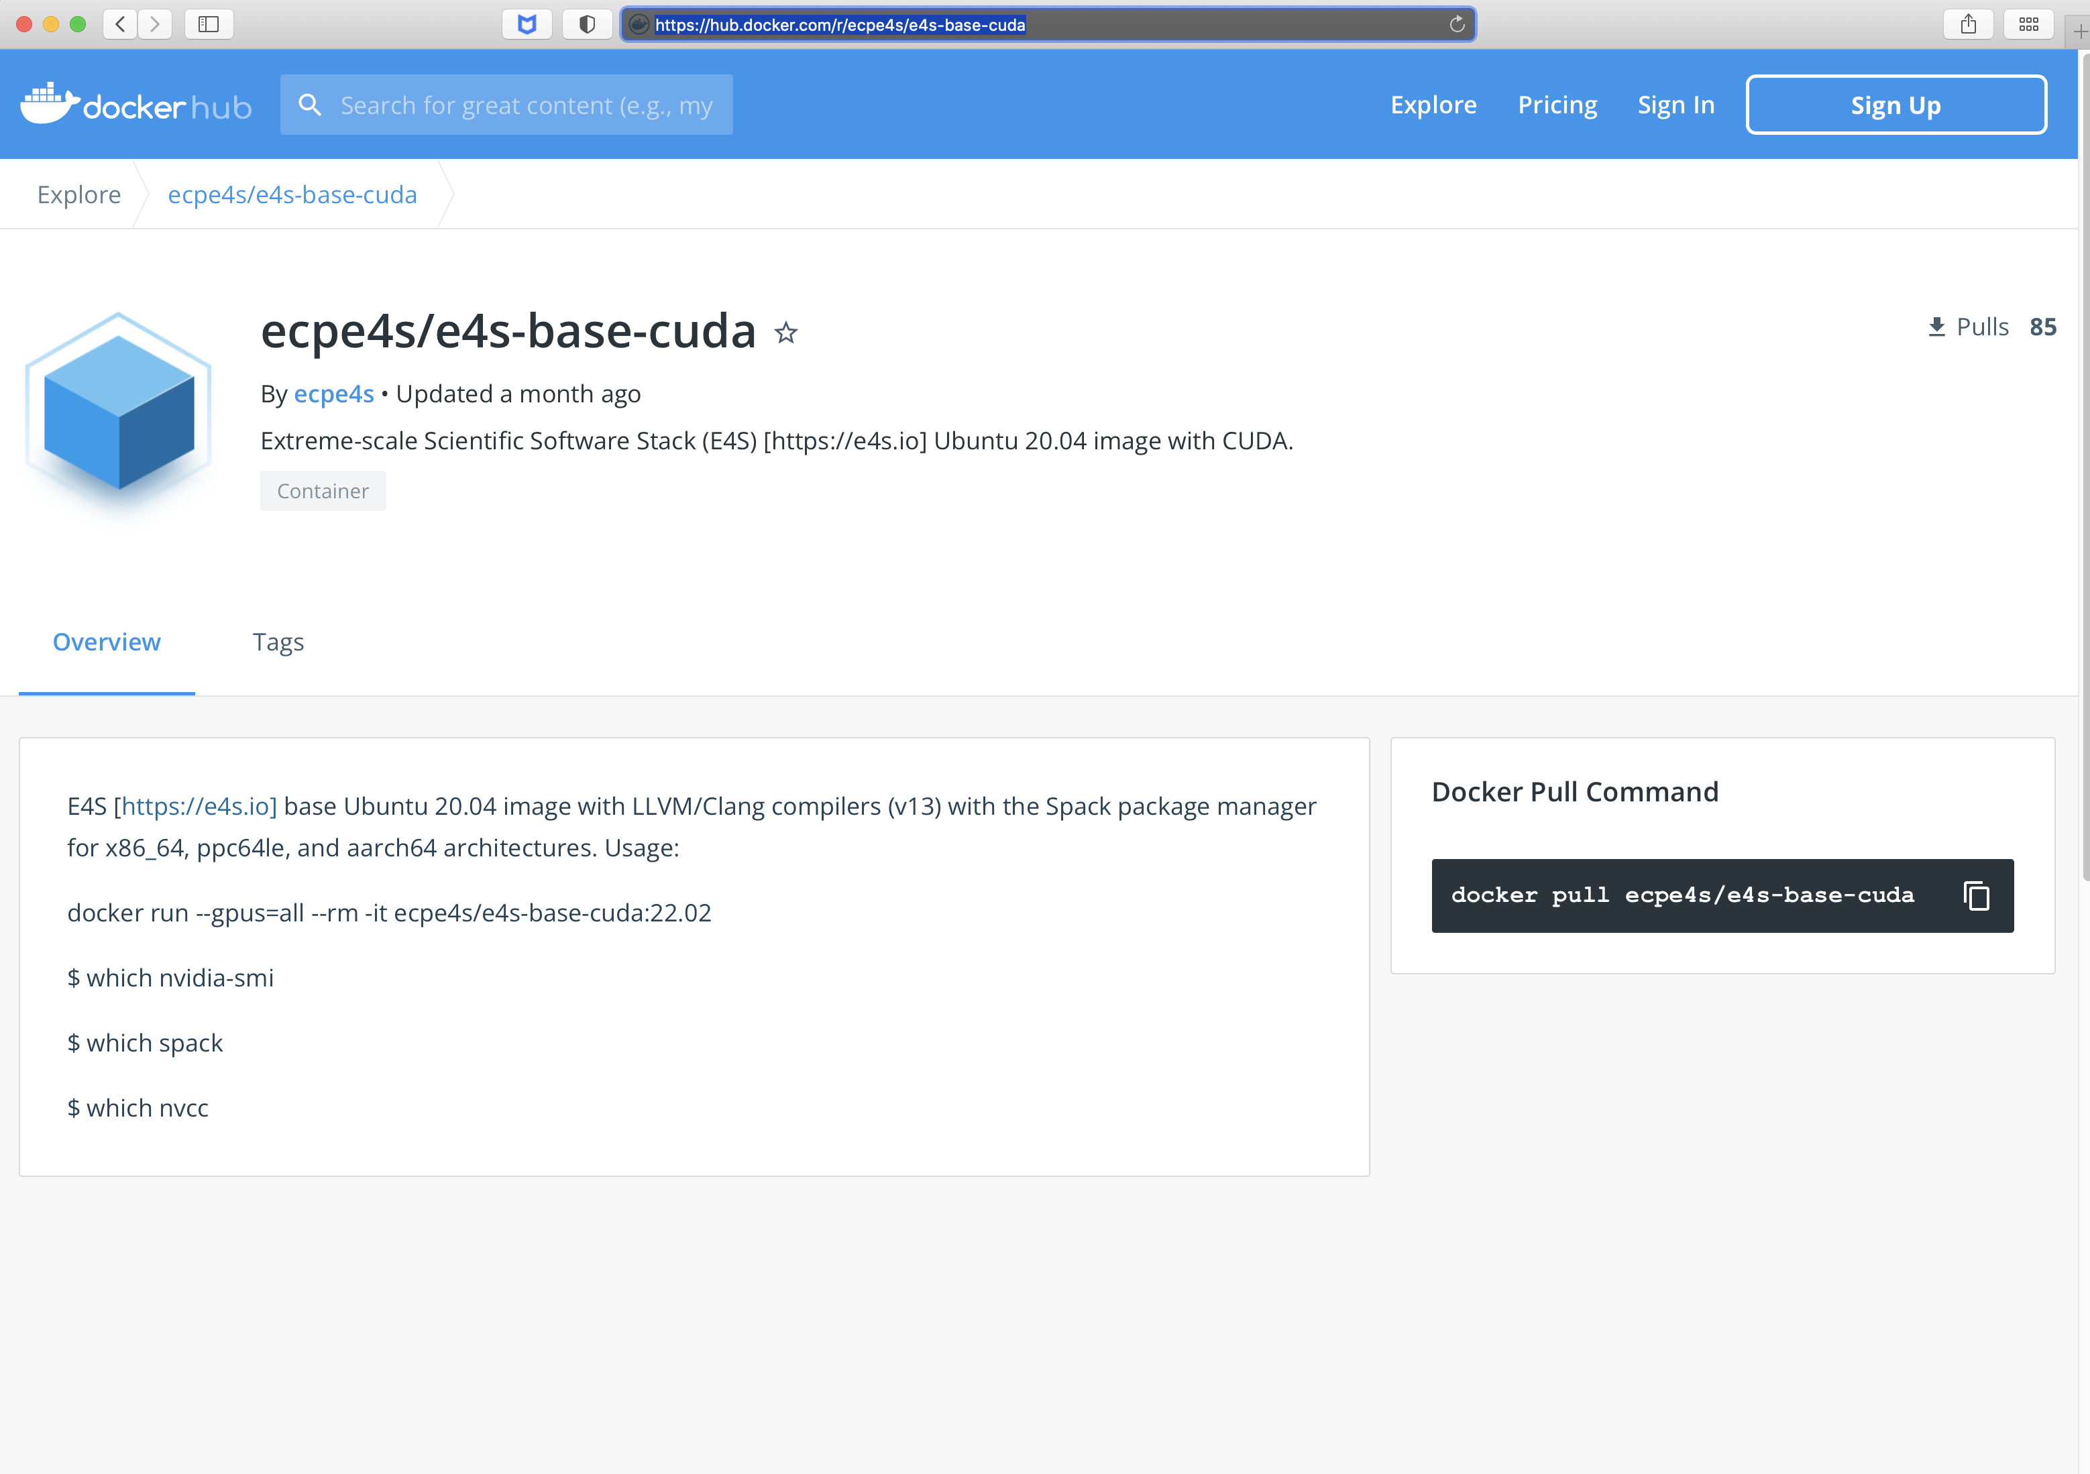
E4S 22.02 NVIDIA GPU Base Image: Ubuntu
Includes gcc, LLVM, and
CUDA, NVHPC compilers
Supports NVIDIA GPUs
  x86_64
  ppc64le
  aarch64

Slide 19
E4S 22.02 NVIDIA GPU Base Image: Ubuntu
Includes gcc, LLVM, and
CUDA, NVHPC compilers
Supports NVIDIA GPUs
  x86_64
  ppc64le
  aarch64

Slide 20
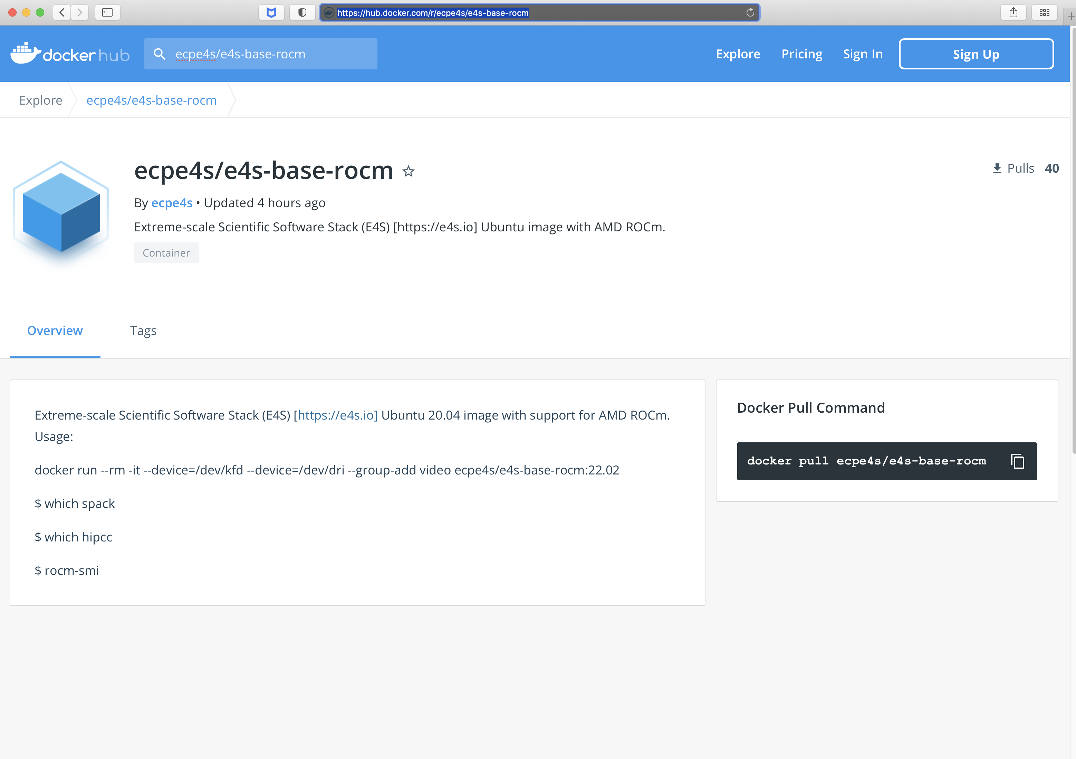
E4S 22.02 AMD GPU Base Image: Ubuntu
Includes gcc, LLVM, and
CUDA, NVHPC compilers
Supports AMD GPUs
ROCm 4.5.2, HIP

Slide 21
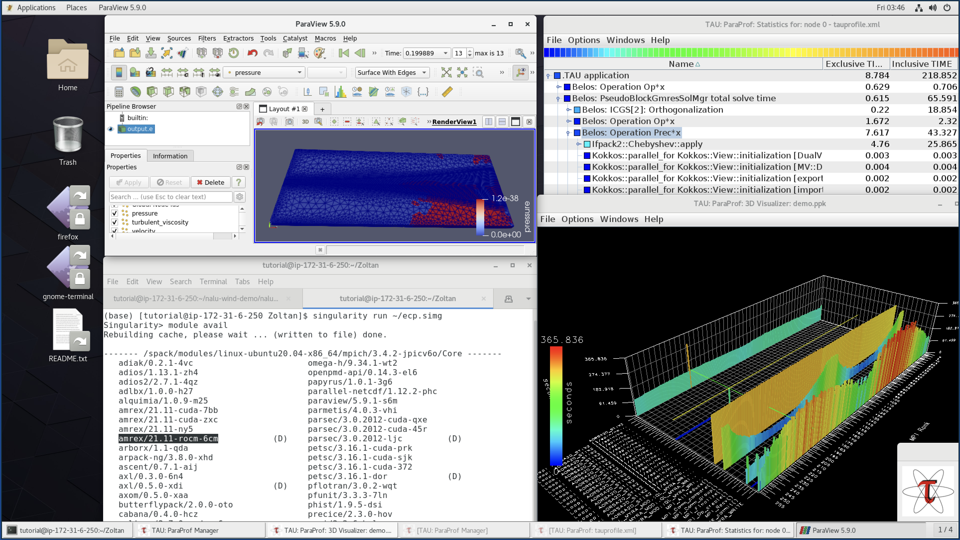
E4S 22.02 AWS image: US-West2 (OR) ami-0b25a3c02556d434e
E4S 22.02 AWS
Intel oneAPI
CUDA
NVHPC
ROCm
AWS DCV
Spack Build Cache
ECP: Nalu-Wind
OpenFOAM
ParaView
VisIt
TAU
Docker
Shifter
Charliecloud
E4S Singularity…
SC22: Using containers for reproducibility of scientific results for AE/AD submission
Notes:
quick run through - what ECP ST is working on

Slide 22
E4S: Using Docker containers with Intel® compilers
% docker pull ecpe4s/e4s-base-oneapi:22.02
% docker images
% docker run --shm-size=4g --rm -it ecpe4s/e4s-base-oneapi:22.02
# source /opt/intel/oneapi/setvars.sh
# export I_MPI_FABRICS=shm
# mpicc foo.c -o foo; mpirun -np 4 ./foo
In another terminal:
% docker ps
<container_id> …
% docker cp <tarball> <container_id>:/tmp
% docker commit <container_id> <Your_image_name>
(e.g., docker commit 0x232e2af ecpe4s/e4s-base-oneapi:2022-03-14)
% docker login –u <loginid>
  Password: <password> (Optionally create an account at https://hub.docker.com)
% docker push <Your_image_name> NOTE: You may to your image name on Dockerhub in the AD/AE submission
(e.g., docker push ecpe4s/e4s-base-oneapi:2022-03-14)

Slide 23
E4S: Using Docker containers with NVIDA and AMD GPUs
% docker pull ecpe4s/e4s-base-cuda:22.02
% docker run --gpus=all --rm -v <hostdir>:<containerdir>
-it ecpe4s/e4s-base-cuda:22.02
# which nvcc
% docker pull ecpe4s/e4s-base-rocm:22.02
% docker run --rm --device=/dev/kfd --device=/dev/dri
--add-group=video -it ecpe4s/e4s-base-rocm:22.02
# which hipcc
NOTE: If you do not commit and save your image, your changes will be lost when you exit docker. Use docker run –e to specify environment variables (docker run --help)

Slide 24
Building your own custom Docker container
docker build –t hello:1.0 .
docker run --rm -it hello:1.0
# Hi.sh
Hello World!
# exit
To export the image to Dockerhub:
docker tag hello:1.0 janedoe/hello:1.0
docker login –u janedoe
docker push janedoe/hello:1.0
% docker pull ecpe4s/e4s-base-cuda:22.02
% docker run --gpus=all --rm -it ecpe4s/e4s-base-cuda:22.02
# whoami
# cat /etc/os-release
Creating a Dockerfile
mkdir myapp
cd myapp
Create a shell script Hi.sh (vi Hi.sh)
#!/bin/bash
echo “Hello World!”
Create a file called Dockerfile:
From ecpe4s/e4s-base-cuda:22.02
LABEL maintainer=“JaneDoe janedoe@janedoe.org”
ADD ./Hi.sh /bin/Hi.sh
RUN chmod a+rx /bin/Hi.sh

Slide 25
Using Singularity/Apptainer [sylabs.io]
% wget https://oaciss.uoregon.edu/e4s/images/22.02/e4s-x86_64-cuda.sif
% singularity run -E -B $HOME:$HOME --nv ./e4s-x86_64-cuda.sif /bin/bash --rcfile /etc/bash.bashrc
Singularity> which nvcc
Singularity> nvidia-smi
Build the application, send SC the location of the tarball that can be used with a given image (specify image).

Slide 26
Thank you
https://www.exascaleproject.org
This research was supported by the Exascale Computing Project (17-SC-20-SC), a joint project of the U.S. Department of Energy’s Office of Science and National Nuclear Security Administration, responsible for delivering a capable exascale ecosystem, including software, applications, and hardware technology, to support the nation’s exascale computing imperative.
Thank you to all collaborators in the ECP and broader computational science communities. The work discussed in this presentation represents creative contributions of many people who are passionately working toward next-generation computational science.

